Slide 1
MUSIC GENRE CLASSIFICATION
TEAM MEMBERS:
19R11A04G8-K UDAY
19R11A04G9-M PRAVAN
19R11A04H0-M SAMHITHA
19R11A04H3-M VASU DEVARAJU
19R11A04H4-M SRIJA

Slide 2
INTRODUCTION:
Sound is represented in the form of an audio signal having parameters like frequency, decibel, bandwidth etc. A typical audio signal can be expressed as a function of Amplitude and Time.
Music Analysis is done based on a song’s digital signatures for some factors, including acoustics, danceability, tempo, energy etc., to determine the kind of songs that a person is interested to listen to.
Automatic musical genre classification can assist humans or even replace them in this process and would be of a very valuable addition to music information retrieval systems.

Slide 3
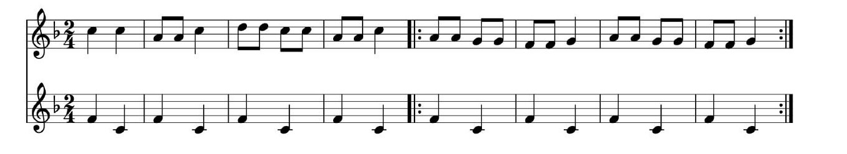
Dividing music into genres is arbitrary, but there are perceptual criteria that are related to instrumentation, structure of the rhythm and texture of the music that can play a role in characterizing particular genre.
Until now genre classification for digitally available music has been performed manually. Thus, techniques for automatic genre classification would be a valuable addition to the development of audio information retrieval systems for music.

Slide 4
Problem statement:
To build a machine learning model which classifies music into its respective genre.
To compare the accuracies of this machine learning model and the pre-existing models, and draw the necessary conclusions.
Developing a machine learning model that classifies music into genres shows that there exists a solution which automatically classifies music into its genres based on various different features, instead of manually entering the genre.
Another objective is to reach a good accuracy so that the model classifies new music into its genre correctly

Slide 5
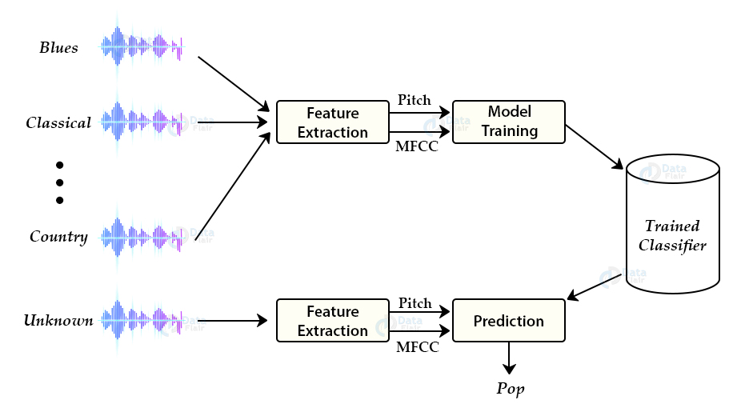
METHODOLOGY:

Slide 6
dataset:
The GTZAN genre collection dataset was collected in 2000-2001. It consists of 1000 audio files each having 30 seconds duration. There are 10 classes ( 10 music genres) each containing 100 audio tracks. Each track is in .wav format. It contains audio files of the following 10 genres:
Blues
Classical
Country
Disco
Hip-hop
Jazz
Metal
Pop
Reggae
Rock

Slide 7
Music Genre Classification approach:
There are various methods to perform classification on this dataset. Some of these approaches are:
Multiclass support vector machines
K-means clustering
K-nearest neighbors
Convolutional neural networks
In this project we use K-nearest neighbors algorithm because in various researches it has shown the best results for this problem.
K-Nearest Neighbors is a popular machine learning algorithm for regression and classification. It makes predictions on data points based on their similarity measures i.e. distance between them.

Slide 8
MODEL BUILDING:
Import all the required libraries.
We need to define a function to calculate distance between two instances. Here one instance will be fixed and second will be changed one by one from the entire dataset .
We need to define functions to get neighbors , their entire dataset corresponding labels are returned into a list.
We need to define a function to predict the nearest class and should create a dictionary file which stores k value pairs and number of votes received.
We then sort the dict and return the first element which is the class that got max votes.

Slide 9
We need to load the data from Audio files to machine readable format
Create a binary “.dat” file to add data generated from the audio files.
We make a list of all the genres available and parse through each folder to read all the files and extract the data from them.
Now these two along with the label (that is the number associated to the folder we’re currently having the audio file) are combined to form a tuple and that tuple is added into the “.dat” file.
we created an empty list named “dataset”, added the my.dat file’s data to it and then converted it to an NumPy array to proceed further

Slide 10
Splitting the data: We split the X data only, as we have defined the algorithm on our own
Here, every single file’s data from the X Test is being matched with all the train data and then, the final prediction is being stored into predictions
Evaluating the model: We first define a function to evaluate the accuracy by counting total no. of correct predictions divided by the total no. of predictions made.

Slide 11
APPLICATION BUILDING:
To build flask application:
Load required packages.
Initialize the flask app and load the saved data file.
Define functions required to calculate distances ,neighbors and make predictions.
Configure the home page and pre-process the frame and run.
Based on the prediction the output text is generated and sent to the HTML to display.
Build an html page to take an audio file as an input and display the output that is passed from the flask app.
HTML describes structure of a web page

Slide 12
8. This class name is printed as output on the html page along with a sentence that describes the output more.
9. Run the flask application using the run method. By default the flask runs on Port number 5000. If the port is to be changed, an argument can be passed to do so.
Now Open the browser and navigate to localhost: 5000 to check your application.

Slide 13
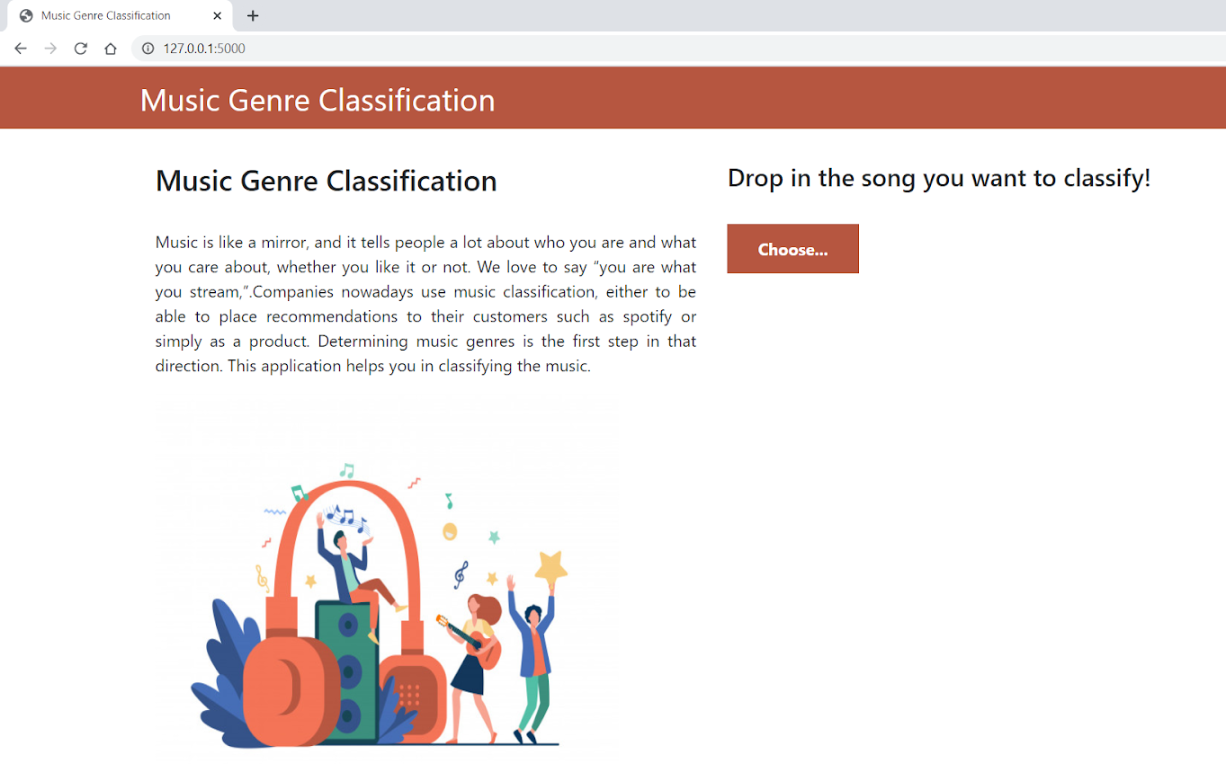

Slide 14
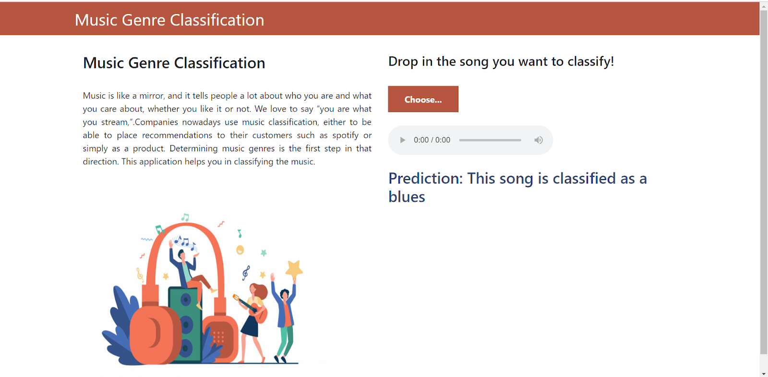
Here we can browse and choose the audio file we want to predict genre for and then click on predict to get the predictions.

Slide 15

THANKYOU 🙏

